Slide 1

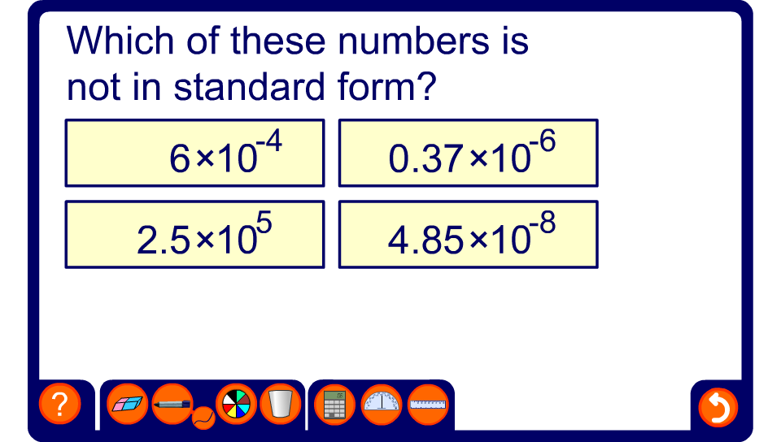


Which number is incorrect?
Notes:
Ask pupils how the number that is incorrectly written can be expressed correctly in standard form before revealing the answer.

